Slide 1
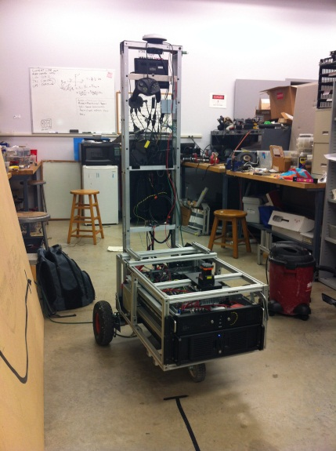
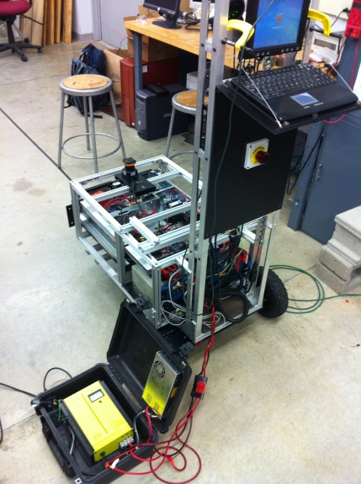
Rose-Hulman Institute of Technology
2012 IGVC Design Entry: Moxom’s Master
Team Members:
Allison Crump, Rain Dart, Kyle Green, Ben Griffith, Derek Heeger, Alex Memering, Michael Pauly, Ander Solorzano, Trent Tabor, Dmitry Votintsev, Elias White, Ruffin White
Team Advisor:
Dr. David Mutchler (Ph.D. Computer Science)

Slide 2
Presentation Overview
Overall Design Plan
Hardware Features and Improvements
Overall Software Design Concept
Software Features and Innovations
Concluding Remarks and Future Plans

Slide 3
Overall Design Plan
Determine objectives and goals
Create parts inventory
Construct frame and install sensors and computer
Durable and reliable
Modular and easy to change
Intelligent
Low Power Consumption
Safe
Create and test software algorithms
Observe and verify performance
Make changes and improvements if needed

Slide 4
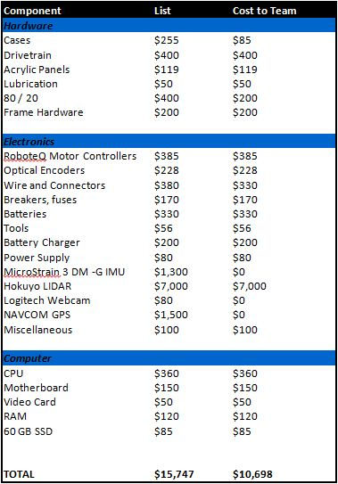
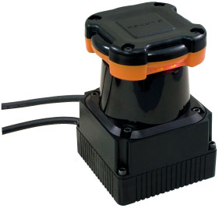
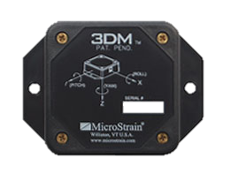
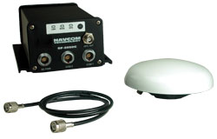
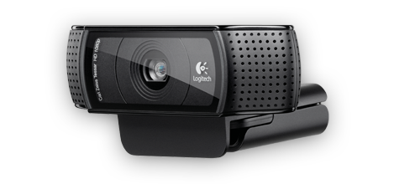
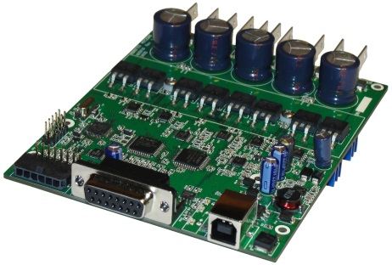

Major components and costs
HOKUYO LIDAR
MicroStrain IMU
NAVCOM GPS
Logitech Webcam
RoboteQ Motor Controller
Intel i5 Core

Slide 5
Mechanical features and improvements
Shortened case and lightened mast to decrease weight
Improved encoder to motor shaft connection
Added shocks to dampen bounce and add durability
Modified wheel base to improve mobility
Observed changes in performance
Adds stability and durability to sensors
Increased turning speed
Heavier on the back wheels
Meets physical constraints

Slide 6
Electrical Features and improvements
Replaced SICK LIDAR with Hokuyo model for increased angular scan
Replaced Black Jaguar motor controllers with RoboteQ motor controller
Replaced old emergency shut off switch for increased safety
Moved the battery charger off of the robot to decrease weight
Replaced the Elphel camera with a Logitech webcam for easier communication
Incorporated the WAAS features of the GPS for increased accuracy
Observed changes in performance
Increased obstacle detection view
Increased agility
Faster and sufficient line detection
Reduced power consumption
Faster and reliable response in case of emergency
Reliable waypoint navigation

Slide 7
Overall software design concept
Sense
Initialize all sensors and gather data from the environment
Think
Process all gathered data and determine best plan of action
Act
Use the motor to turn or head towards the goal through a safe and efficient path

Slide 8
Software implementation
Start sense loop
Start think loop
Start act loop
Stop sense loop
Handle events
and visualize inputs
Stop act loop
Stop think loop
Graphical
Intuitive building
Fast programming
Robotics friendly environment
Understandable by different engineers
Easy debugging

Slide 9
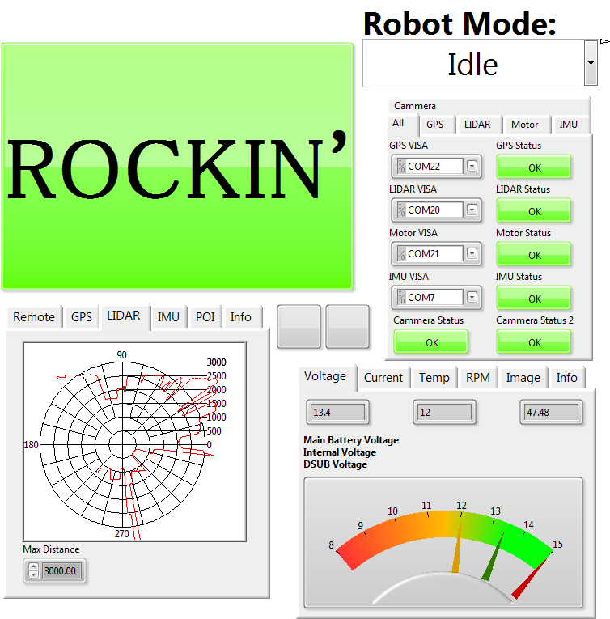
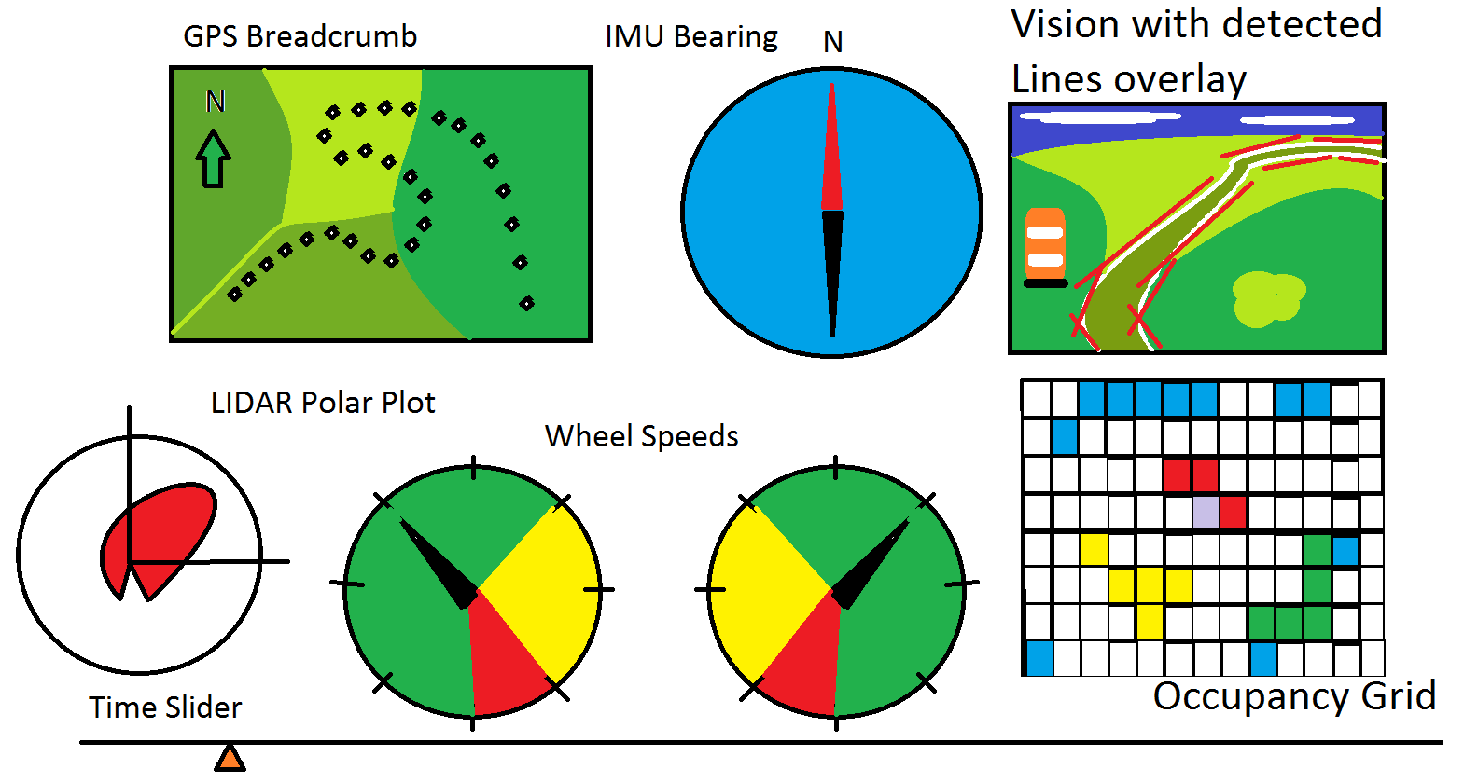
Over View

Slide 10
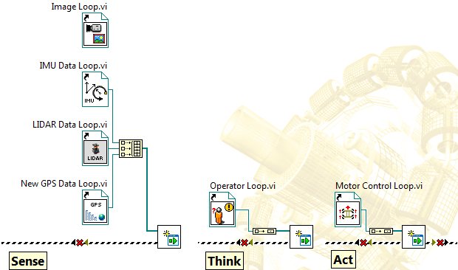
Framework
Sense
Think
Act

Slide 11
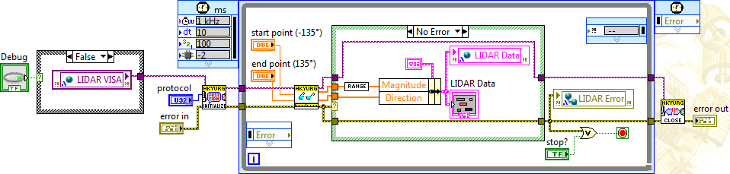
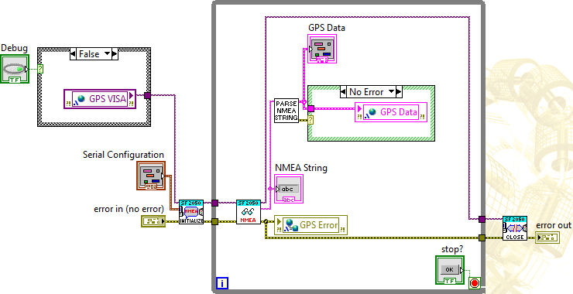
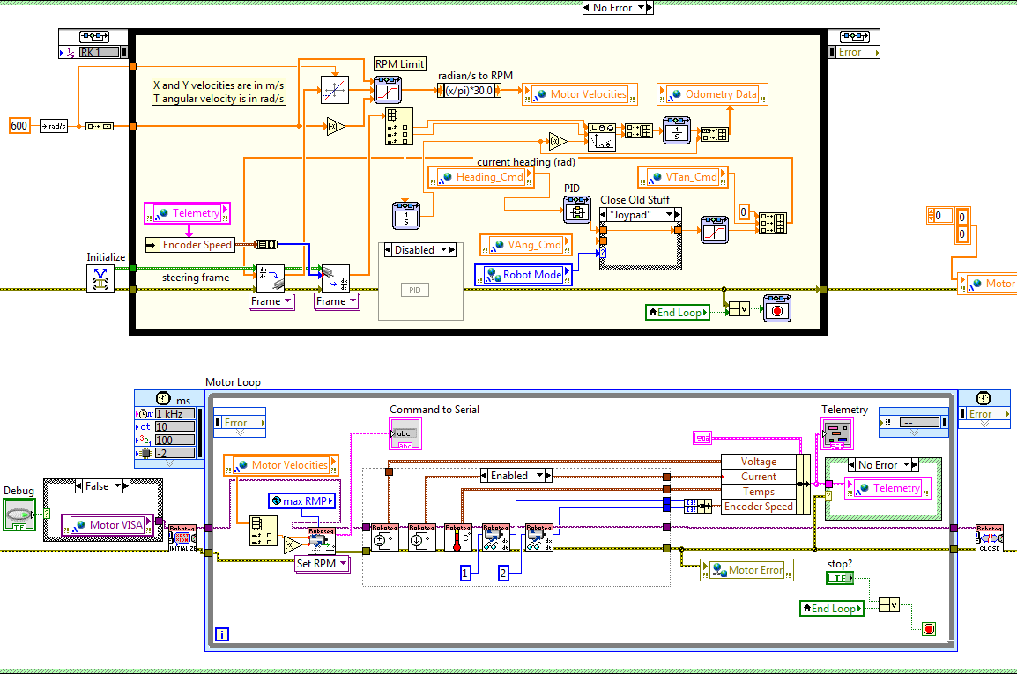
Sensor loops

Slide 12
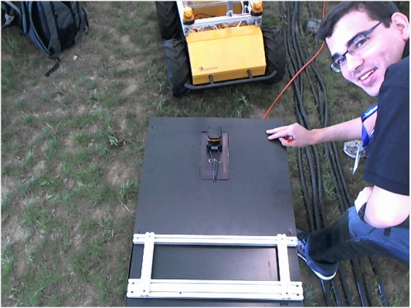
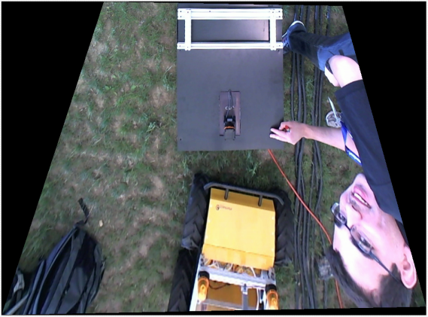
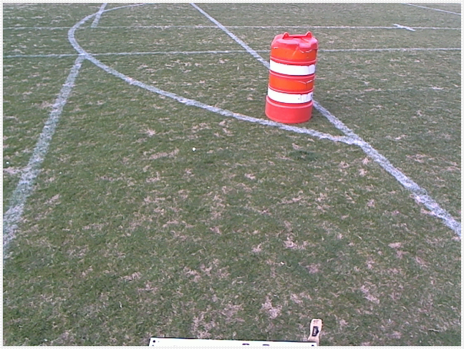
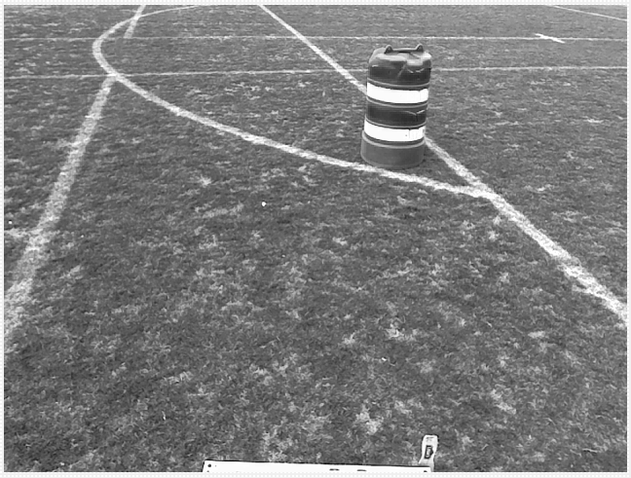
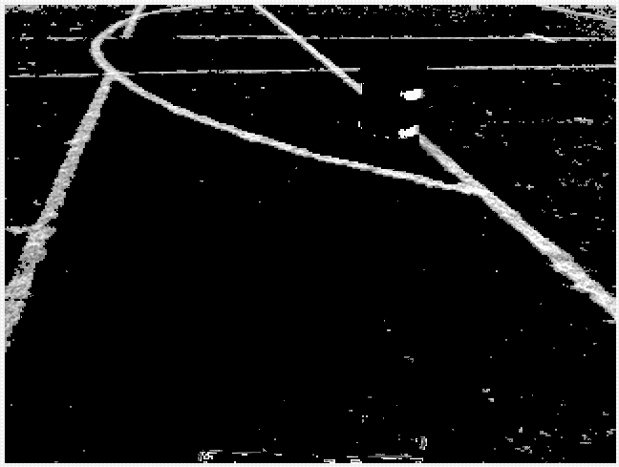
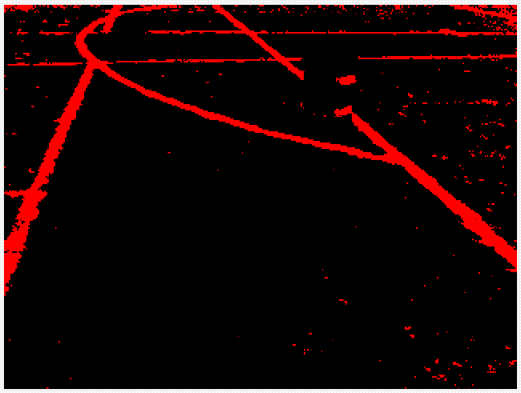
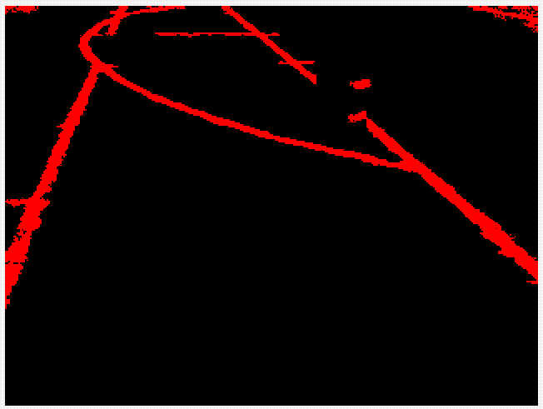
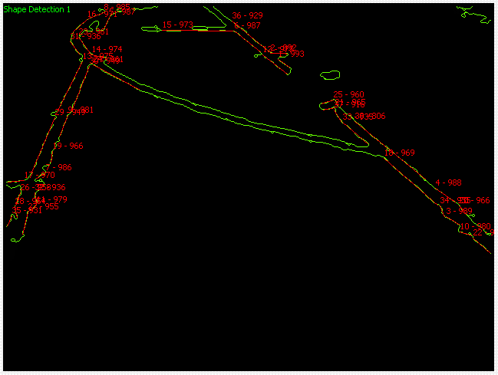
Vision acquisition

Slide 13
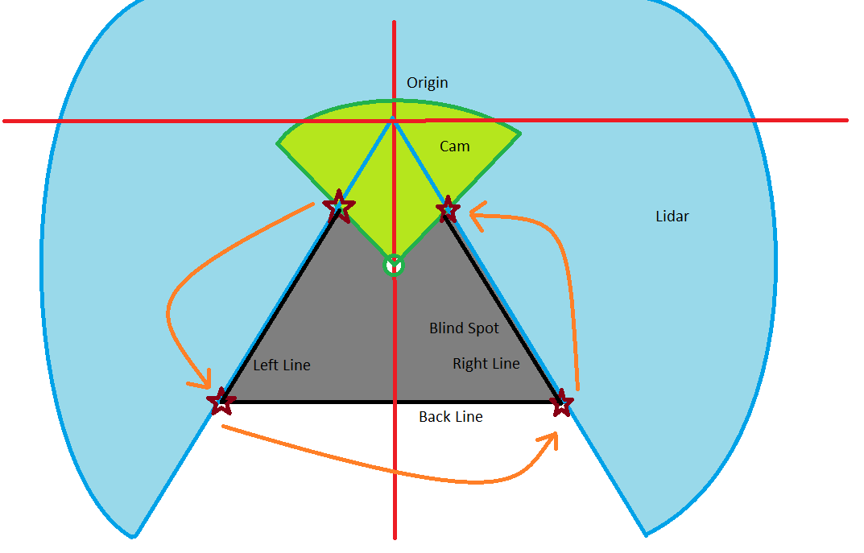
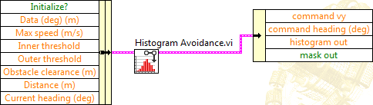
Obstacle detection

Slide 14
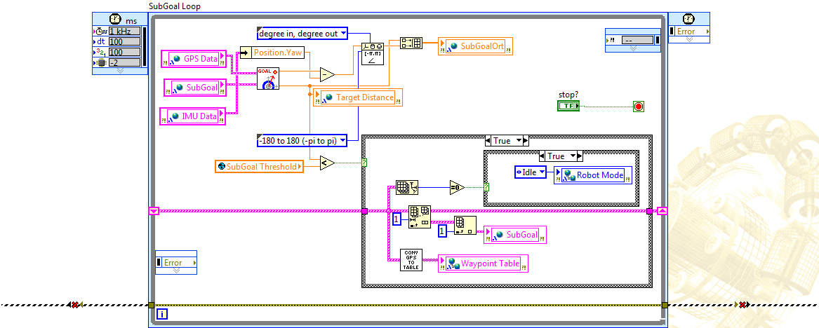
Waypoint travel

Slide 15
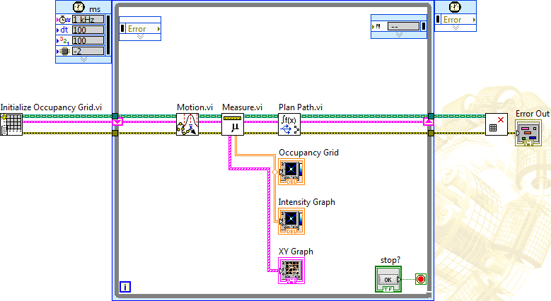
Occupancy grid
Sense
Think
Act

Slide 16
Concluding remarks
Strengths of Moxom’s Master
Drawbacks of Moxom’s Master
Original design
Unique and strong software design
Capacity to meet all objectives
Easy to make changes
Reliable safety mechanisms
On-board monitor and router
Heavy and tall on the back
Mechanically unstable
Small drive wheels for off-road terrain
Low power output
Expensive design

Slide 17
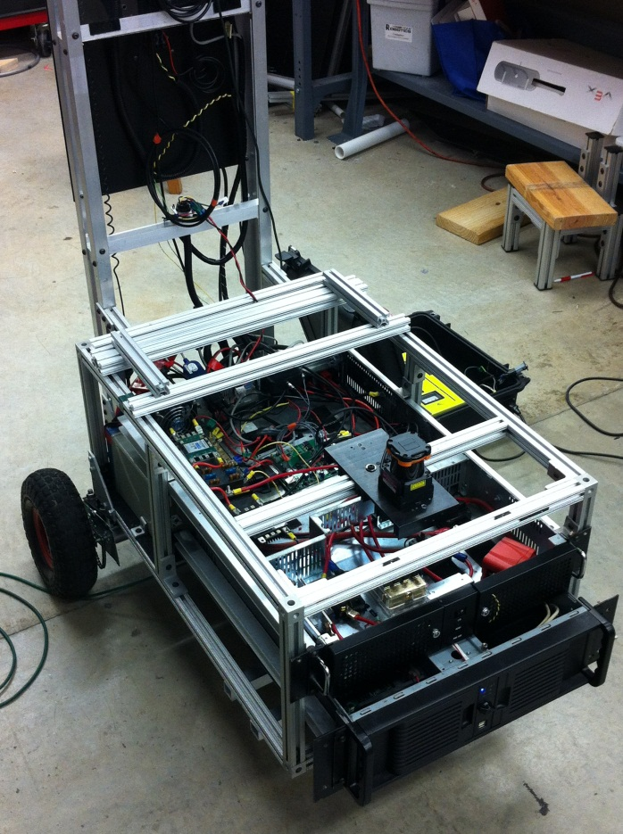
Future plans
Keep improving software
Need stronger and reliable frame
Construct new robot design
Change weight distribution
Increase power output

Slide 18





acknowledgements
Partner Sponsor
Other Sponsors

